Slide 1

Environmental Data Science
Module #13300
By Prof. Dr. Masahiro ryo
Data visualization and art

Slide 2
Today’s course?
Right visualization, right communication
Data visualization and art
Notes:
Right dataviz is a critical step to effectively transform data to a powerful piece of evidence to make your story more attractive.

Slide 3

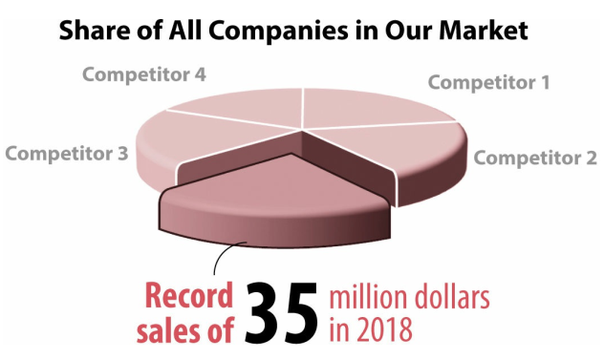
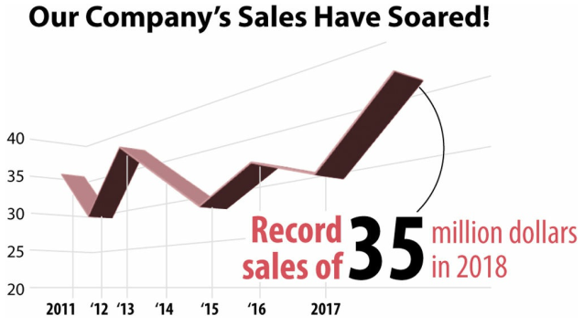
Why Art?
Inappropriate visualization does not offer information or even mislead us.
Appropriate Representation Technique
Alberto Cairo How Charts Lie: Getting smarter about visual information
Notes:
Here are some examples of inappropriate ... that compares the sales of our company and the other competitors. We achieved 35 mil.. and wow! Apparently, we are outcompeting to the others!! 3-D visualizations look so dynamic and powerfully convincing... Do you agree?

Slide 4
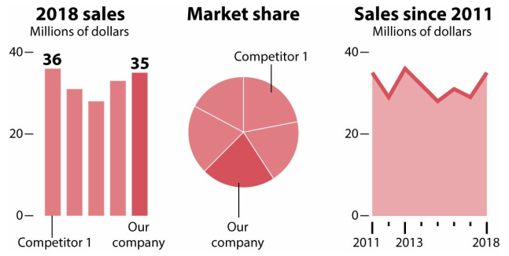
Why Art?
Inappropriate visualization does not offer information or even mislead us.
Appropriate Representation Technique
Alberto Cairo How Charts Lie: Getting smarter about visual information
Notes:
Well, these 3D figures are horrible. To tell the truth, the competitor 1 is the best one, and we are a bit losing against it. We show our sales in 2018 are seemingly the best record, but indeed,... DO NOT USE 3D as IT DISTORTS

Slide 5
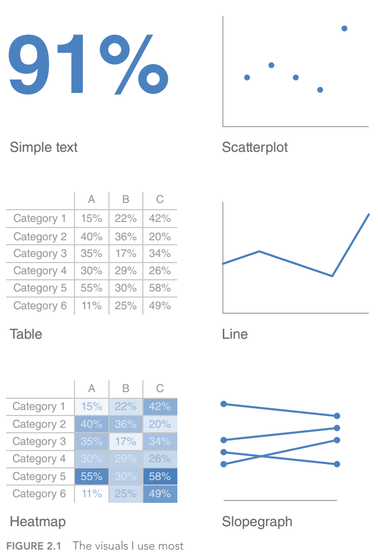
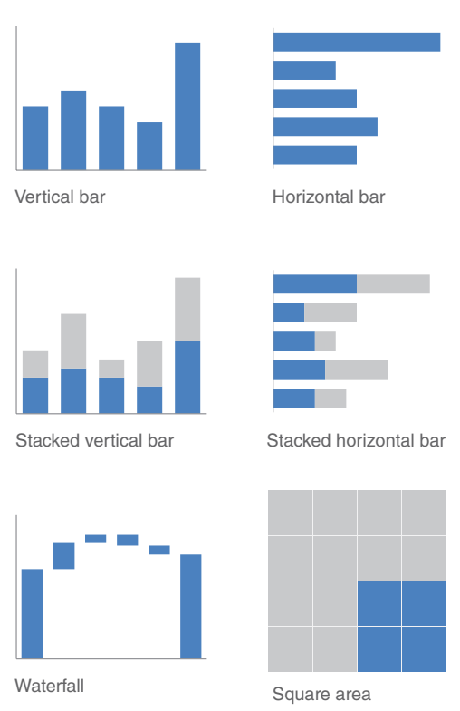
Why Art?
Data visualization styles have been diversifying. We need to know what styles are available & effective.
Appropriate Representation Technique
Knaflic, Cole. Storytelling With Data: A Data Visualization Guide for Business Professionals, Wiley, © 2015.

Slide 6
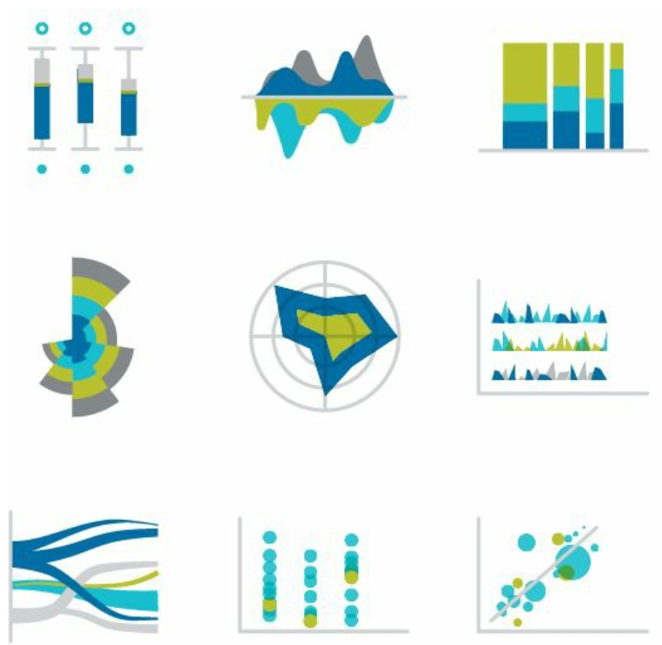
Why Art?
Data visualization styles have been diversifying. We need to know what styles are available & effective.
Appropriate Representation Technique
Data Story © 2019 by Nancy Duarte
Notes:
There are even more advanced ones, rose charts, radar charts, bubble plots, ...

Slide 7
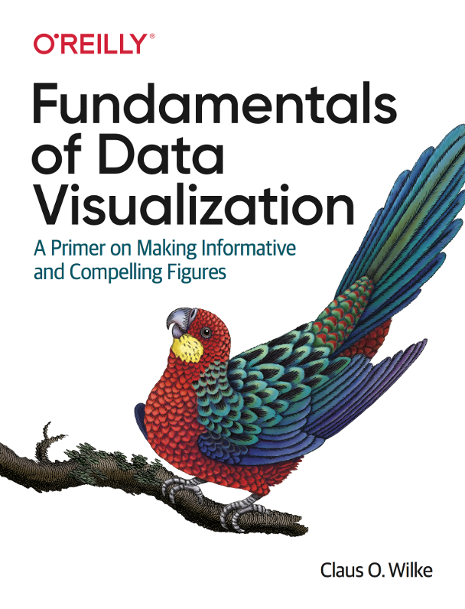
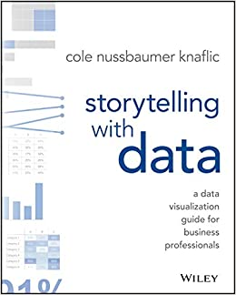
Why Art?
Data visualization styles have been diversifying. We need to know what styles are available & effective.
Appropriate Representation Technique
Notes:
There are even more advanced ones, rose charts, radar charts, bubble plots, ...

Slide 8

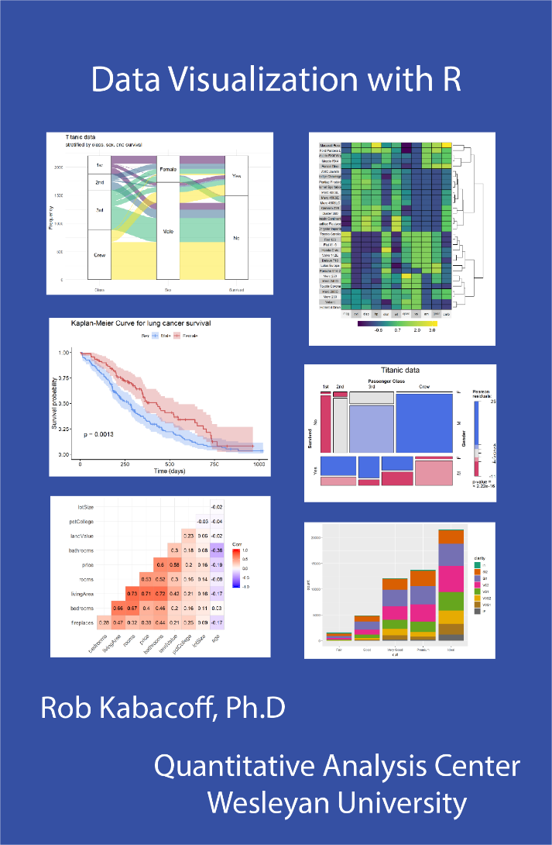
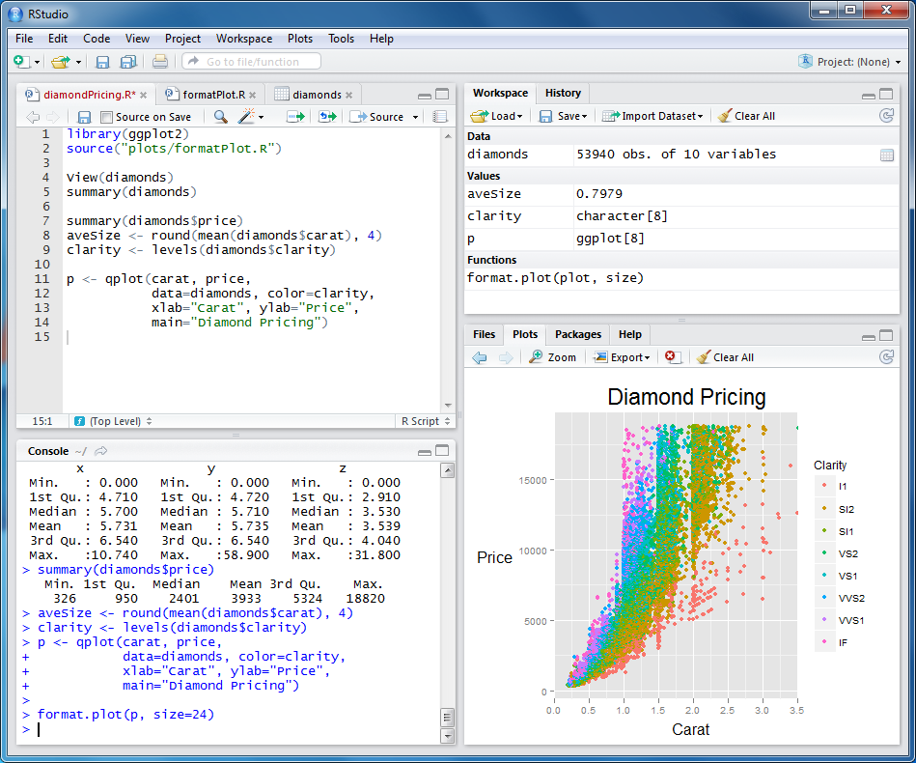
Why Art?
Data visualization styles have been diversifying. We need to know what styles are available & effective.
Appropriate Representation Technique
Notes:
These visualizations can be easily done if you use a programming software, and surely you will learn how to use it later (or maybe already).

Slide 9
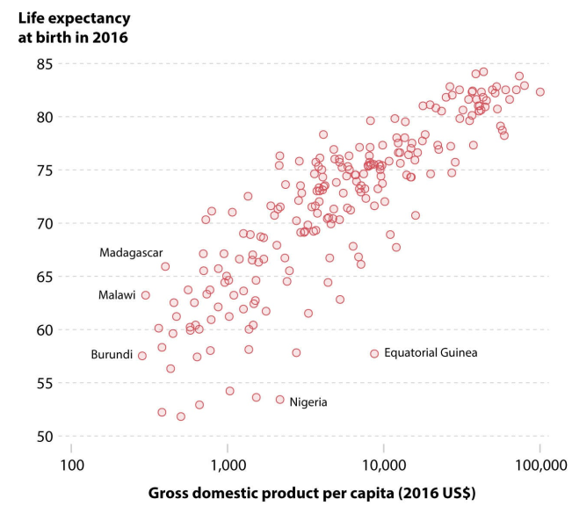
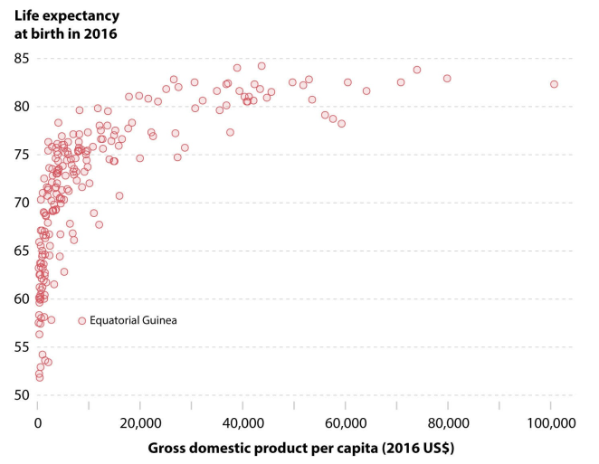
Scaling gives a different impression
Alberto Cairo How Charts Lie: Getting smarter about visual information
Notes:
First: log-transformed = linear. Non-log transformed = highly skewed. Hitting a plateau once exceeding 20,000

Slide 10
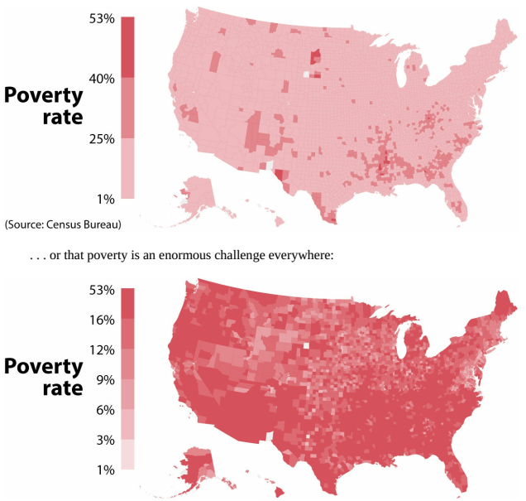
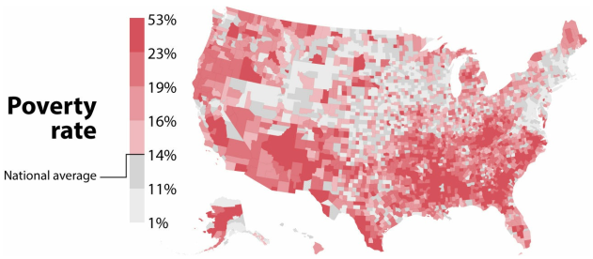
Scaling gives a different impression
Alberto Cairo How Charts Lie: Getting smarter about visual information
Notes:
First: Some hotspots of high poverty. Second: low poverty or not. The scales for coloring are different

Slide 11
Scaling gives a different impression
Alberto Cairo How Charts Lie: Getting smarter about visual information
Notes:
Showing the average (but again, is this mean, median, or mode? median is better for 50:50 in red and grey)

Slide 12
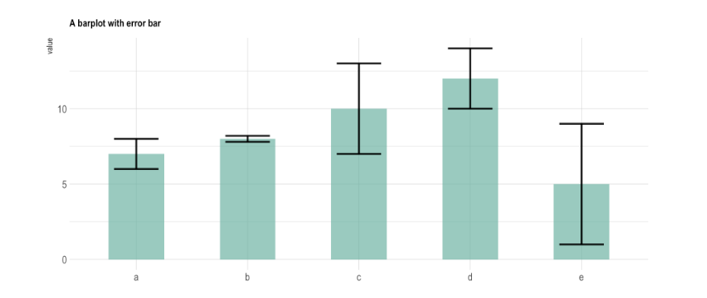
Error bar can have different meanings
The height of a bar: Mean value
How about the error bar?
https://www.data-to-viz.com/caveat/error_bar.html

Slide 13
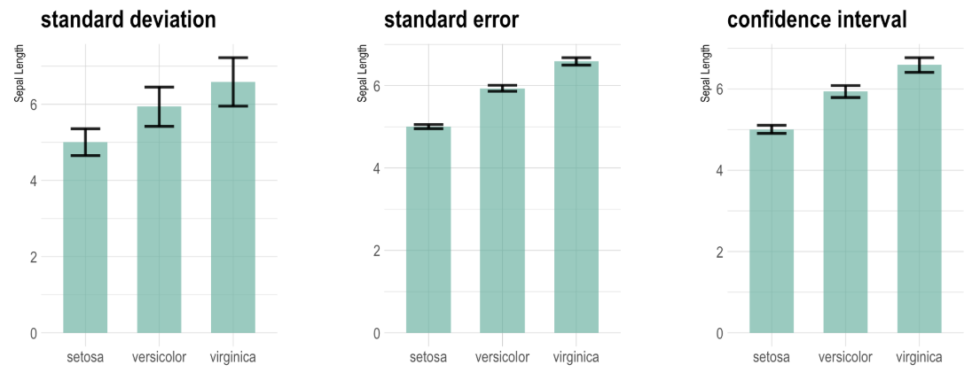
Error bar can have different meanings
Always do describe what the bars represent!
https://www.data-to-viz.com/caveat/error_bar.html

Slide 14
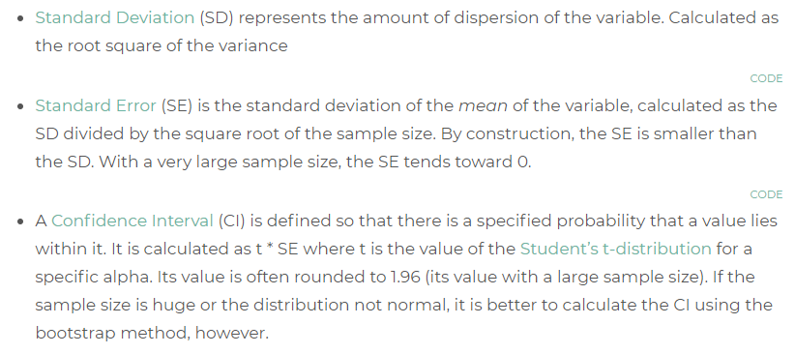
... Wait, can you explain how they differ from each other?
√
Σ(x_{i} – Mean)²
SD =
n
SD
SE =
n
√
95% CI:
1.96*
SE
n
√
https://www.data-to-viz.com/caveat/error_bar.html

Slide 15

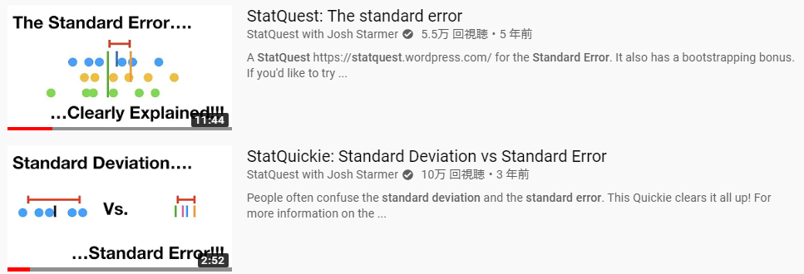
... Wait, can you explain how they differ from each other?
https://www.data-to-viz.com/caveat/error_bar.html

Slide 16
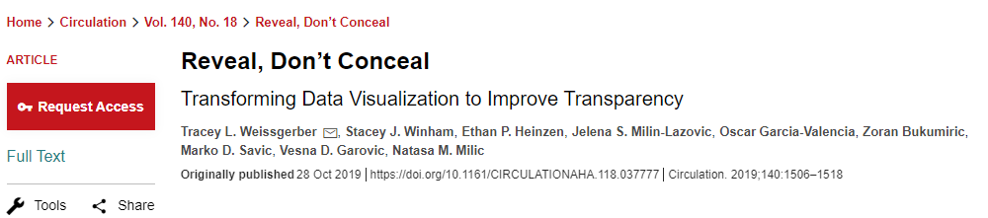
Stop using bar plots
Weissgerber et al. 2019 Circulation 140, 18.

Slide 17
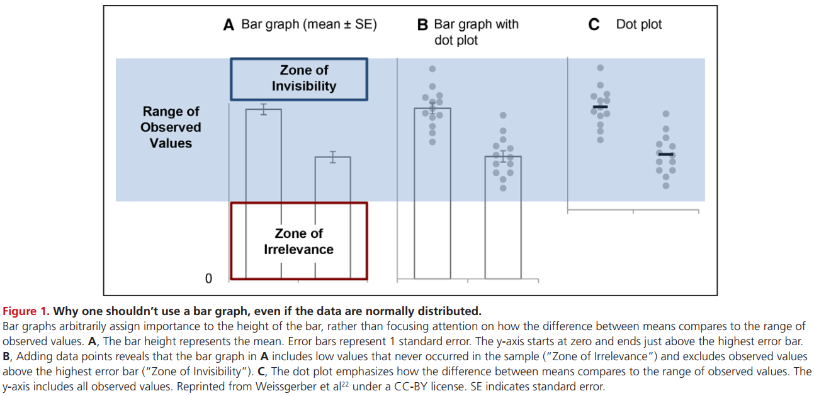
Stop using bar plots
Weissgerber et al. 2019 Circulation 140, 18.

Slide 18
Stop using bar plots
Weissgerber et al. 2019 Circulation 140, 18.

Slide 19
Stop using bar plots
Weissgerber et al. 2019 Circulation 140, 18.

Slide 20
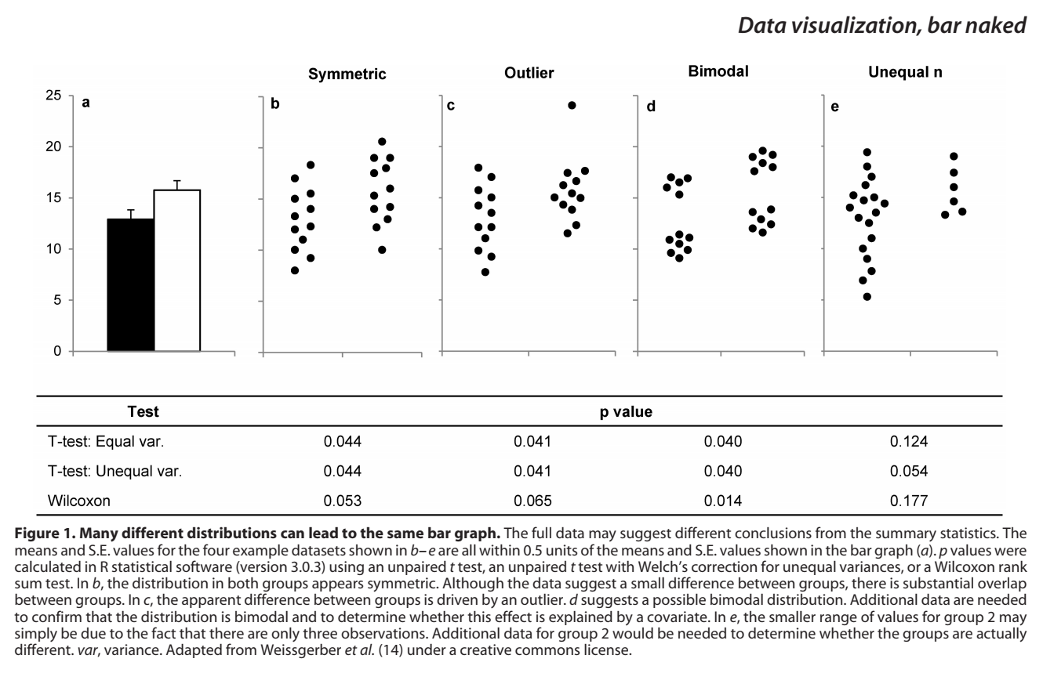
Stop using bar plots
Weissgerber et al. 2017 Data visualization, bar naked
Notes:
The same argument as we did in lie in science

Slide 21
What can be alternatives then?
Weissgerber et al. 2017 Data visualization, bar naked

Slide 22
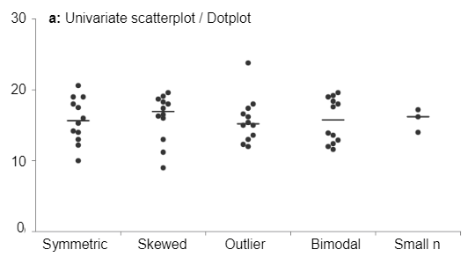
What can be alternatives then?
Weissgerber et al. 2017 Data visualization, bar naked

Slide 23
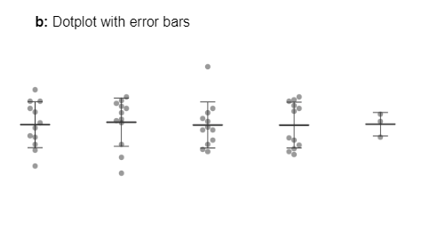
What can be alternatives then?
Weissgerber et al. 2017 Data visualization, bar naked

Slide 24
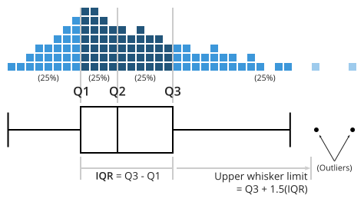
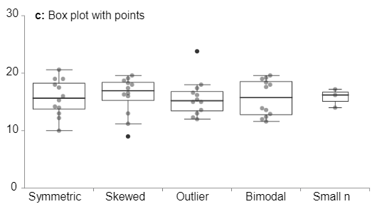
What can be alternatives then?
Weissgerber et al. 2017 Data visualization, bar naked

Slide 25
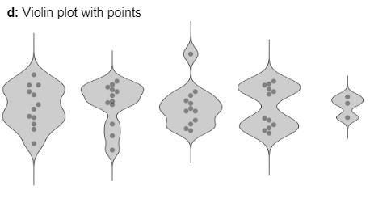
What can be alternatives then?
Weissgerber et al. 2017 Data visualization, bar naked

Slide 26
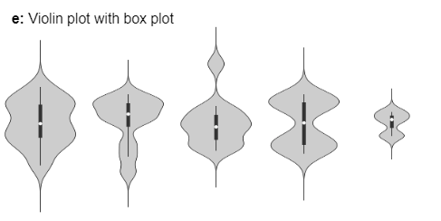
What can be alternatives then?
Weissgerber et al. 2017 Data visualization, bar naked

Slide 27
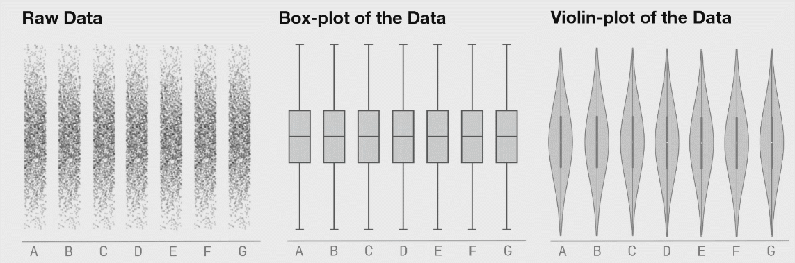
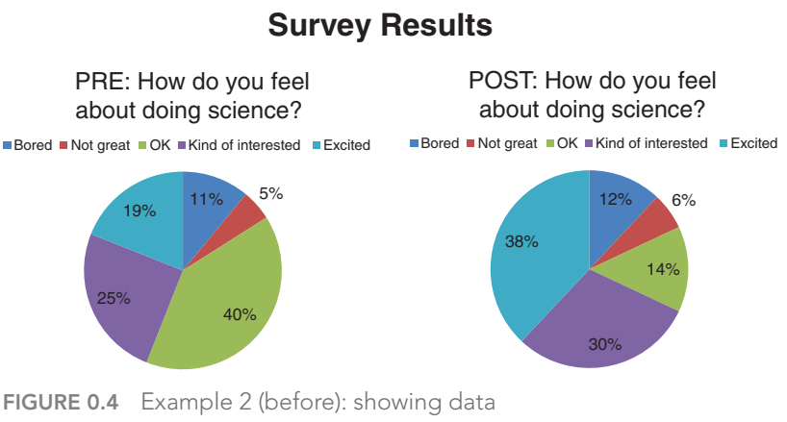
Why Art?
Summary statistics alone can tell a lie.
Appropriate
Representation Technique
Notes:
We just learned “appropriate”

Slide 28
Why Art?
Knaflic, Cole. Storytelling With Data: A Data Visualization Guide for Business Professionals, Wiley, © 2015.
Good design for effective communication
Attractive
Representation Technique
Notes:
We learn “attractive”

Slide 29
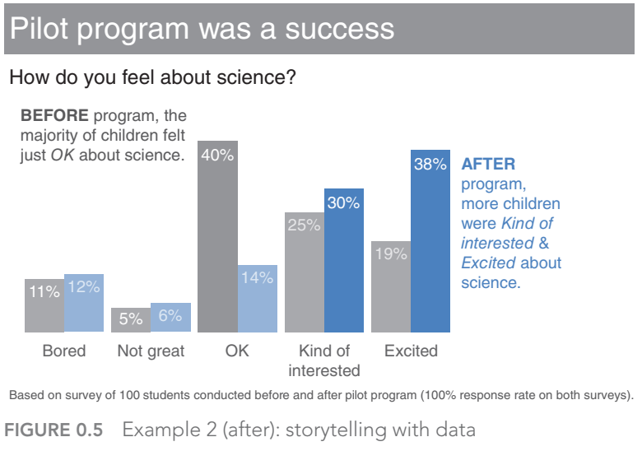
Why Art?
Knaflic, Cole. Storytelling With Data: A Data Visualization Guide for Business Professionals, Wiley, © 2015.
Good design for effective communication
Attractive
Representation Technique
Notes:
We learn “attractive”
Pie chart. It is not effective, no emphasis on anything

Slide 30
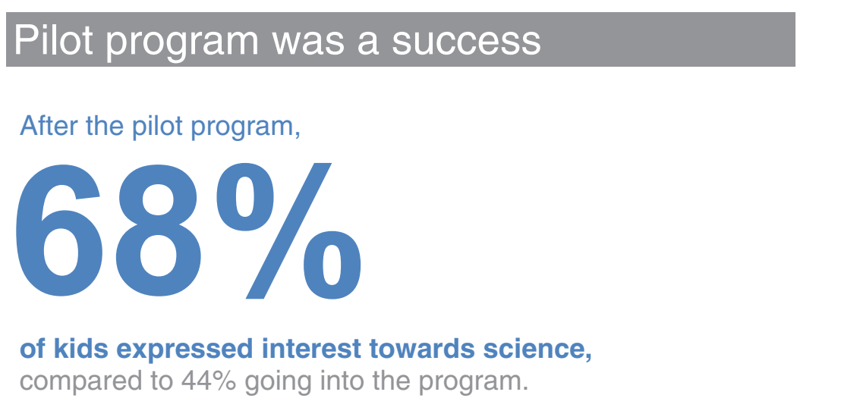
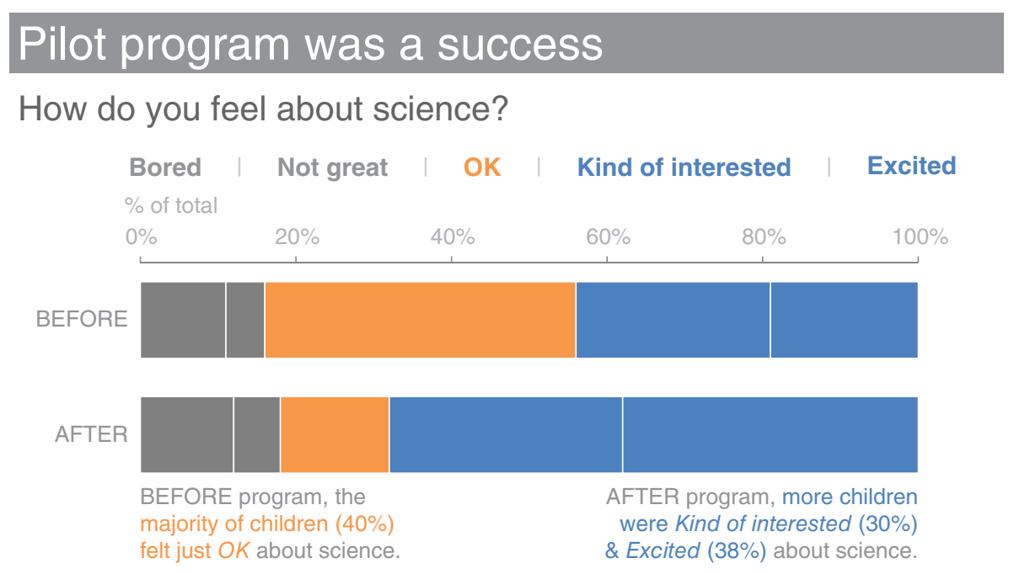
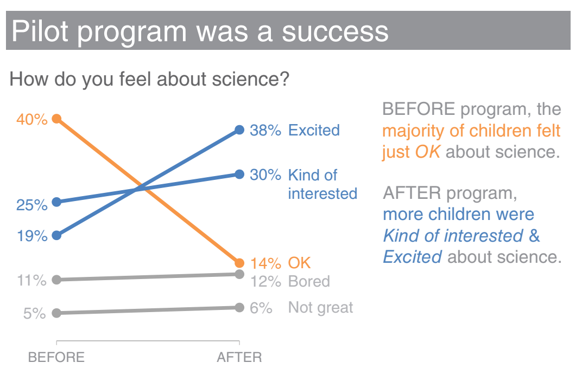
Why Art?
Knaflic, Cole. Storytelling With Data: A Data Visualization Guide for Business Professionals, Wiley, © 2015.
Good design for effective communication
Attractive
Representation Technique
Notes:
It prioritize information. Title and key observation.

Slide 31
Why Art?
Knaflic, Cole. Storytelling With Data: A Data Visualization Guide for Business Professionals, Wiley, © 2015.
Good design for effective communication
Attractive
Representation Technique
Notes:
The data can be visualized in several ways by emphasizing some particular aspects. For story.

Slide 32
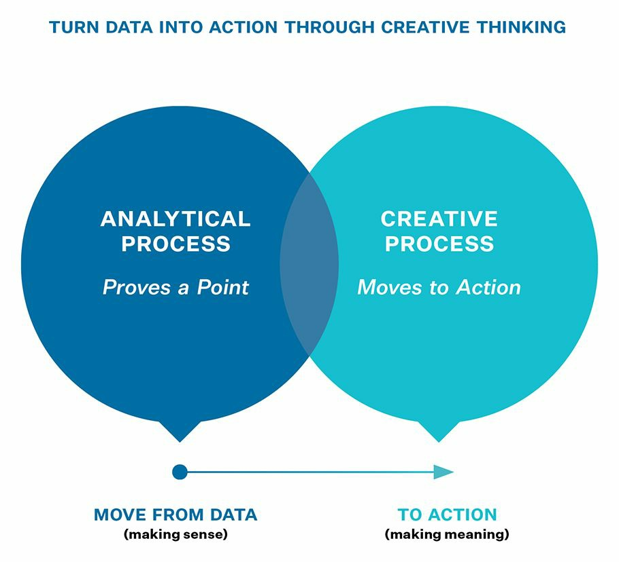
Why Art?
Attractive
Representation Technique
© 2019 by Nancy Duarte “Data Story”
Notes:
Until yesterday, we mainly learned how to analyze and visualize data, which is analytical process, to offer reliable evidence for a good story.
Today, we are shifting our focus from the analytical process to a creative process, to attract audiences with good-looking & effective visualization.

Slide 33
Why Art?
Attractive
Representation Technique
© 2019 by Nancy Duarte “Data Story”
Notes:
Until yesterday, we mainly learned how to analyze and visualize data, which is analytical process, to offer reliable evidence for a good story.
Today, we are shifting our focus from the analytical process to a creative process, to attract audiences with good-looking & effective visualization.

Slide 34
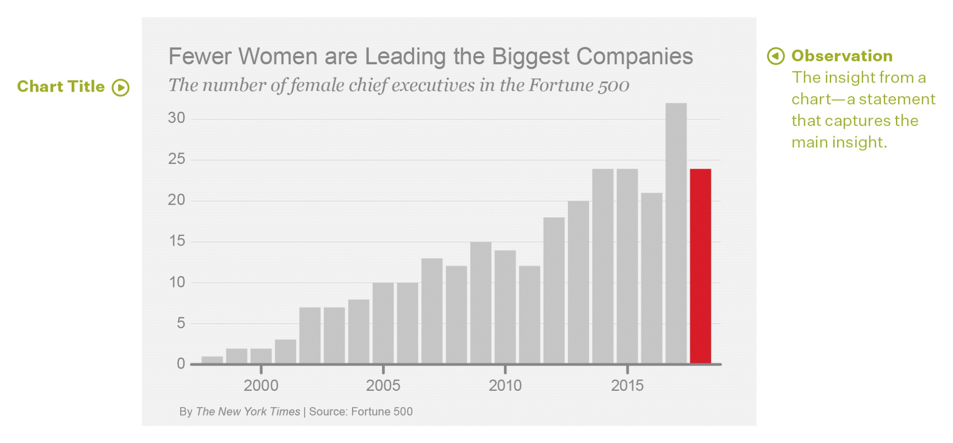
Overlay Visual Annotations onto a Chart
© 2019 by Nancy Duarte “Data Story”
Notes:
You may remember this example, in the 2nd day of this course, some different ways to interpret.

Slide 35


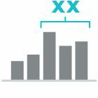


Overlay Visual Annotations onto a Chart
Using visual annotations leads to quicker processing of the point you’re making, in an elegant way
© 2019 by Nancy Duarte “Data Story”

Slide 36
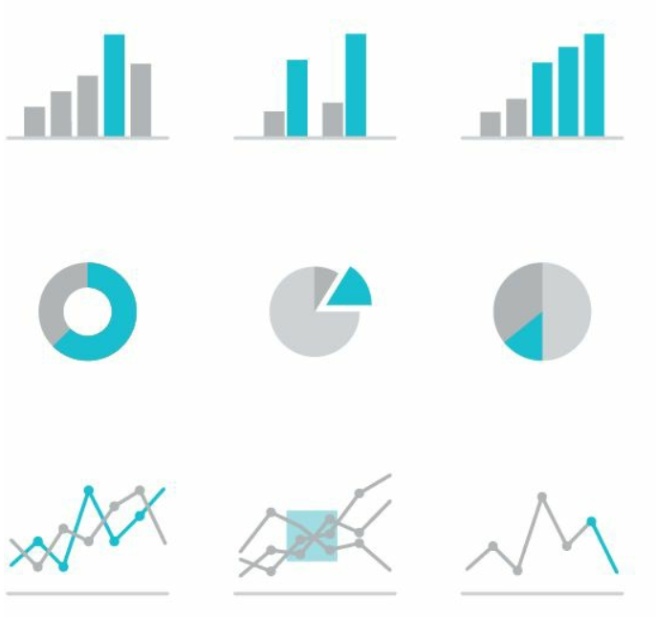
Highlight Data
To make a piece of data stand out, put the secondary chart elements in a neutral or gray color, and use a pop of color for the plotted element you want the eye drawn to.
© 2019 by Nancy Duarte “Data Story”

Slide 37
Highlight Data
To make a piece of data stand out, put the secondary chart elements in a neutral or gray color, and use a pop of color for the plotted element you want the eye drawn to.
© 2019 by Nancy Duarte “Data Story”

Slide 38
Highlight Data
© 2019 by Nancy Duarte “Data Story”

Slide 39
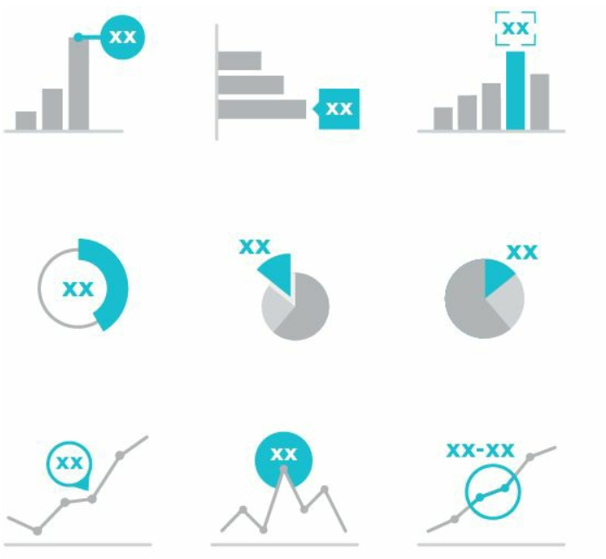
Label a Data Point
If you want to ensure that a specific number in a chart is not overlooked, make that number huge.
© 2019 by Nancy Duarte “Data Story”
Notes:
Combining the number with a graphical label is particularly effective.

Slide 40
Label a Data Point
24 (5%)
© 2019 by Nancy Duarte “Data Story”

Slide 41
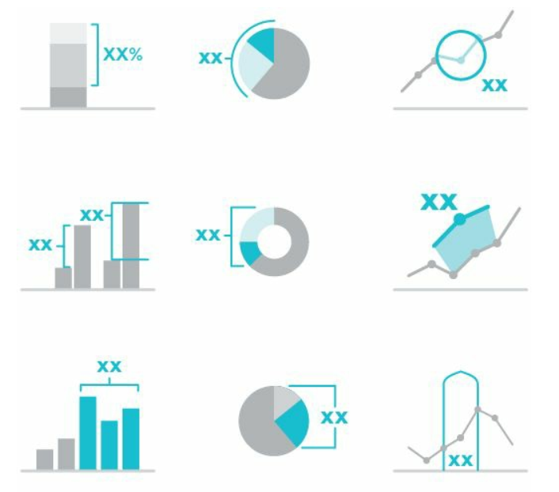
Bracket Data
Visually connect two data points and then add, subtract, or calculate a multiple.
© 2019 by Nancy Duarte “Data Story”

Slide 42
Bracket Data
3yr-mean:26
© 2019 by Nancy Duarte “Data Story”

Slide 43
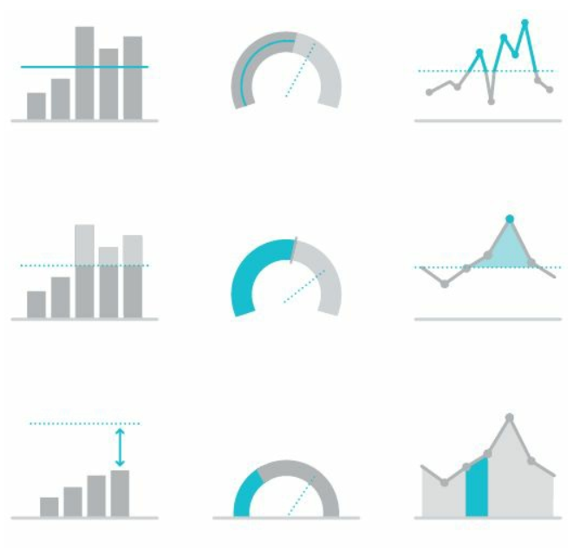
Delineate Data
Use a baseline to compare. Then, show the math demonstrating how good/bad the situation is
© 2019 by Nancy Duarte “Data Story”

Slide 44
Delineate Data
3yr-mean:26
15x
3yr-mean: 1.7
© 2019 by Nancy Duarte “Data Story”

Slide 45
Delineate Data
–25%
© 2019 by Nancy Duarte “Data Story”

Slide 46
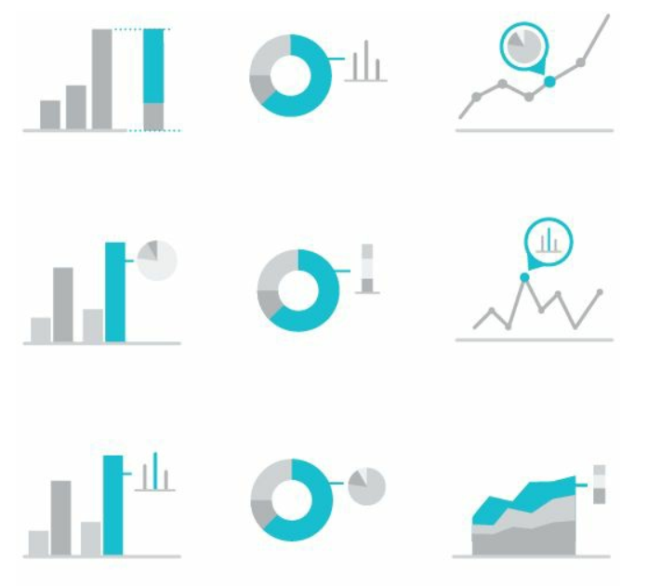
Zoom into Multi-level Data
Categories of data often comprise subcategories (nested). A great way to highlight a subunit is to zoom into a secondary feature.
© 2019 by Nancy Duarte “Data Story”

Slide 47
Zoom into Multi-level Data
68%
© 2019 by Nancy Duarte “Data Story”
Notes:
e.g. Within 24 female chief executives, 68% (the majority) was younger than 40 years old. This number is just imaginary.

Slide 48
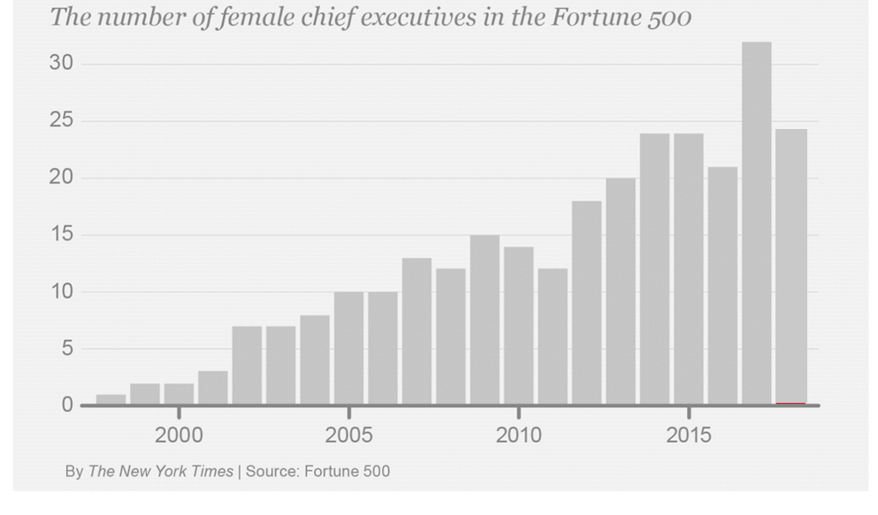
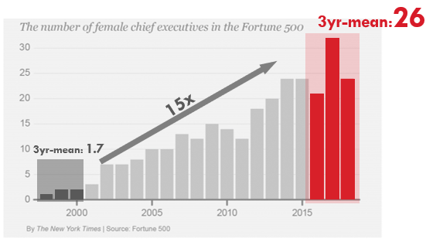
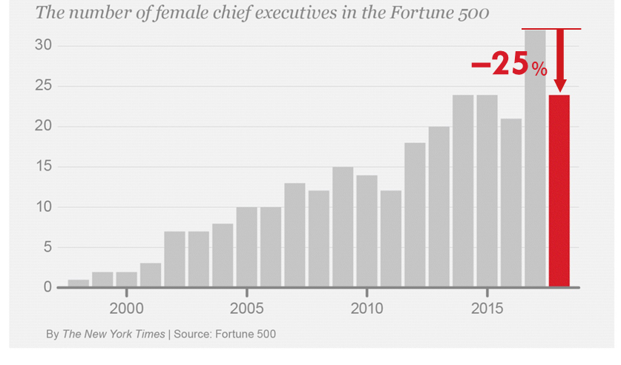
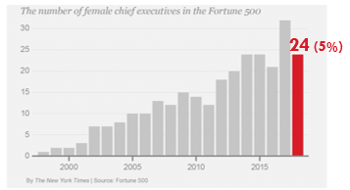
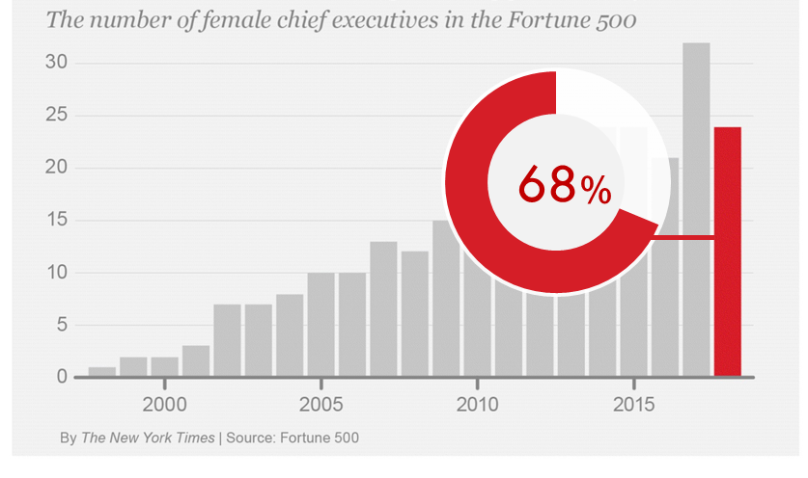
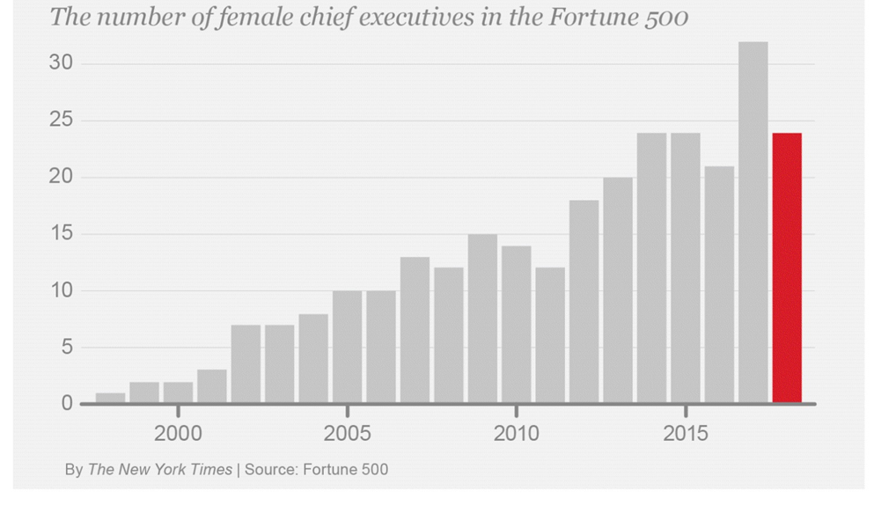
The same data, different stories.

Slide 49
The same data, different stories.

Slide 50

More examples.

Slide 51
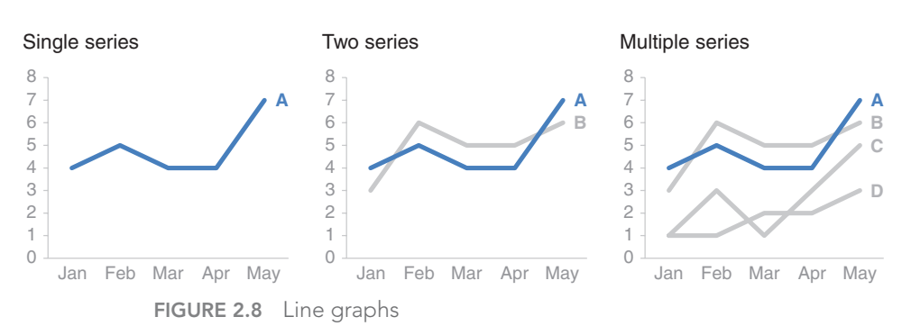
Knaflic, Cole. Storytelling With Data: A Data Visualization Guide for Business Professionals, Wiley, © 2015.
Notes:
Line chart. Light grey for all the information and give a one-point color for an emphasis.

Slide 52
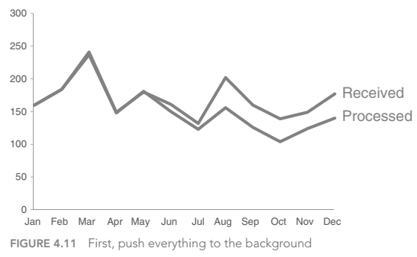
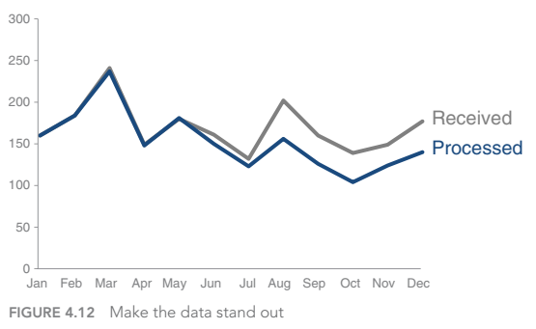


Knaflic, Cole. Storytelling With Data: A Data Visualization Guide for Business Professionals, Wiley, © 2015.

Slide 53


Knaflic, Cole. Storytelling With Data: A Data Visualization Guide for Business Professionals, Wiley, © 2015.
Notes:
Slope graph.

Slide 54


Knaflic, Cole. Storytelling With Data: A Data Visualization Guide for Business Professionals, Wiley, © 2015.
Notes:
We normally do not use heavy borders because it has unnecessary emphasis on borders. How to emphasize some trends?

Slide 55
Knaflic, Cole. Storytelling With Data: A Data Visualization Guide for Business Professionals, Wiley, © 2015.
Notes:
A bit more figure-ish.

Slide 56


Knaflic, Cole. Storytelling With Data: A Data Visualization Guide for Business Professionals, Wiley, © 2015.
Notes:
We put an emphasis on segments 3-5 as they are growing rapidly.

Slide 57
Knaflic, Cole. Storytelling With Data: A Data Visualization Guide for Business Professionals, Wiley, © 2015.
Notes:
We can de-emphasize the others. Drawing a box or border to combine multiple panels is not so cool.

Slide 58


Knaflic, Cole. Storytelling With Data: A Data Visualization Guide for Business Professionals, Wiley, © 2015.
Notes:
Which axis is what? We need to move eyes to several places and need to remember.

Slide 59
Knaflic, Cole. Storytelling With Data: A Data Visualization Guide for Business Professionals, Wiley, © 2015.

Slide 60


Inkscape + R

